Slide 1
Speech Recognition with Python

Slide 2
A voice-user interface (VUI) makes spoken human interaction with computers possible, using speech recognition to understand spoken commands and answer questions, and typically text to speech to play a reply.

Slide 3
What are its Applications

Slide 4
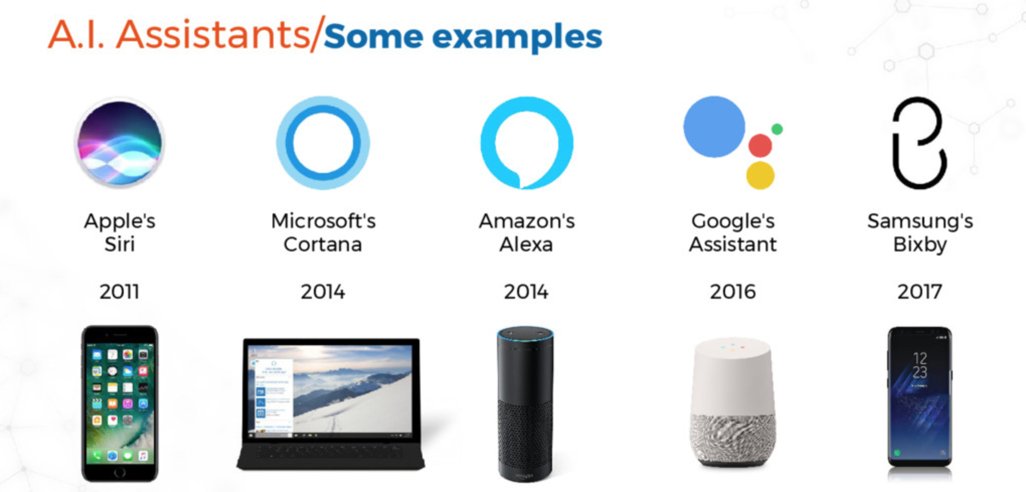

Slide 5
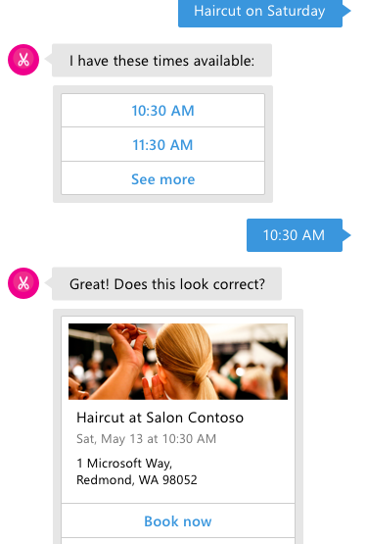
What is a Bot?
A Bot is a conversation based UI
Conversation is based on language
Conversation takes place on a general canvas
Canvas can be: Chat Client: Skype, Team, Slack, Messenger Voice: Echo, Cortana Skills, Siri, Google Now App: Website, App

Slide 6
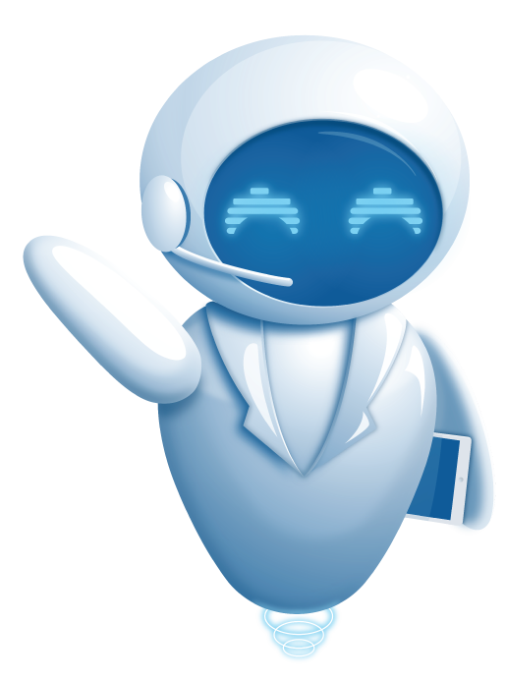
Scenarios for Bots
Question and Answers
Automate Helpdesk, Handoff to human if too complex
Product selection and ordering
Task Automation
Proactive Assistance & Monitoring
Expert Systems

Slide 7
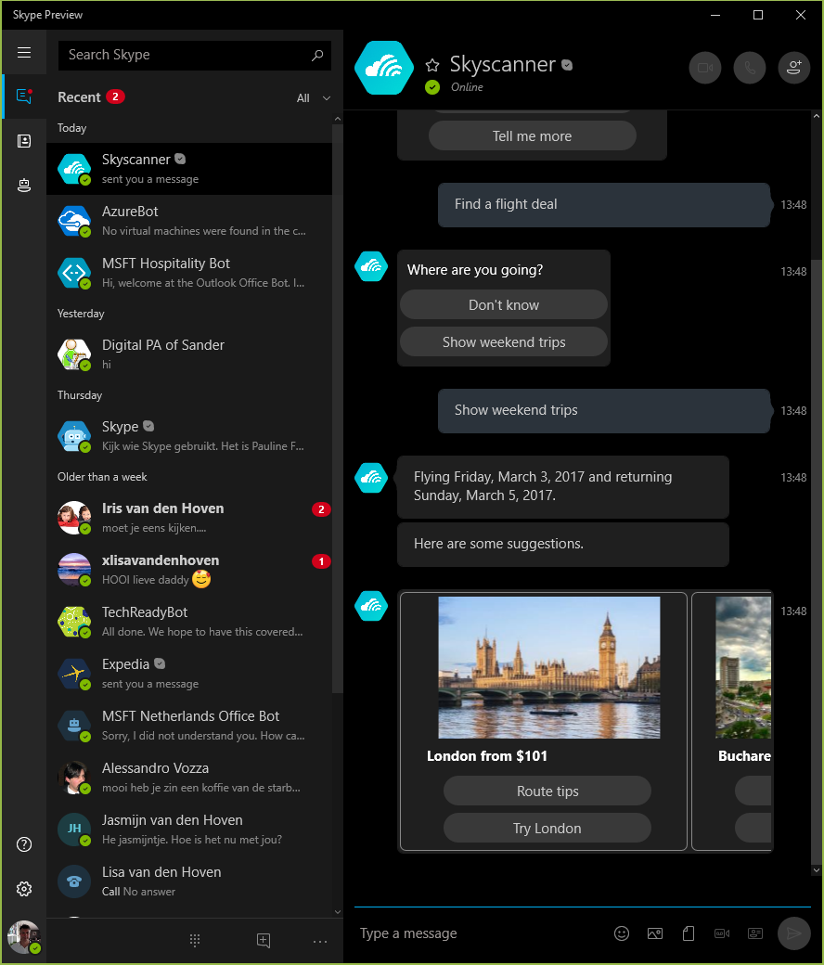
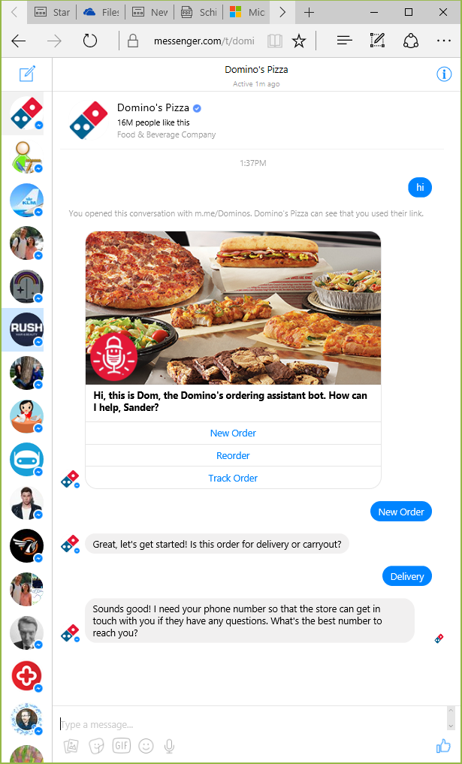
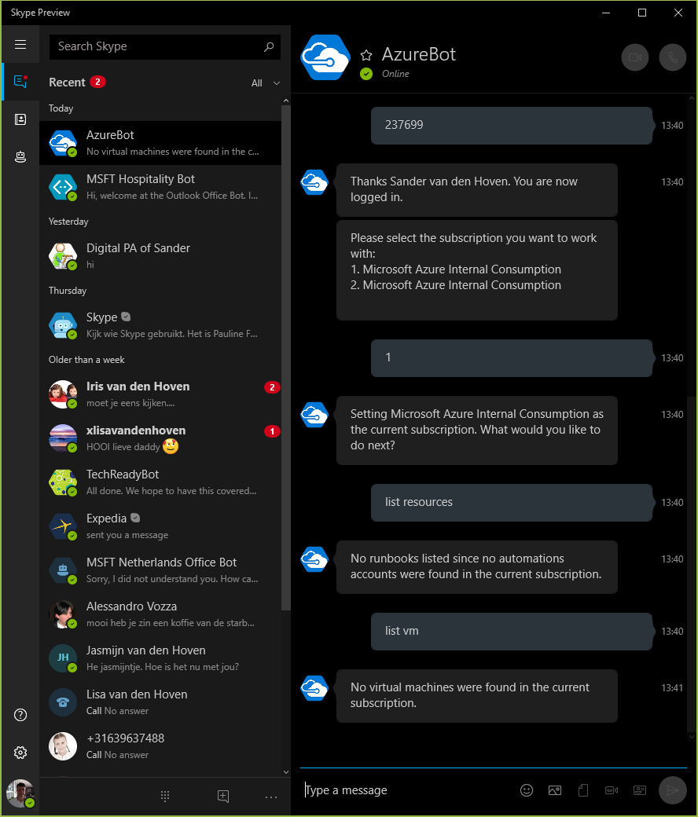
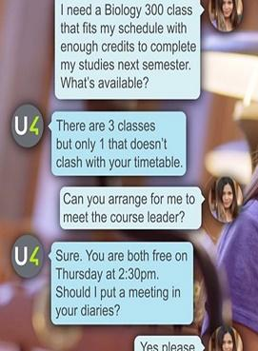
Bot Examples

Slide 8
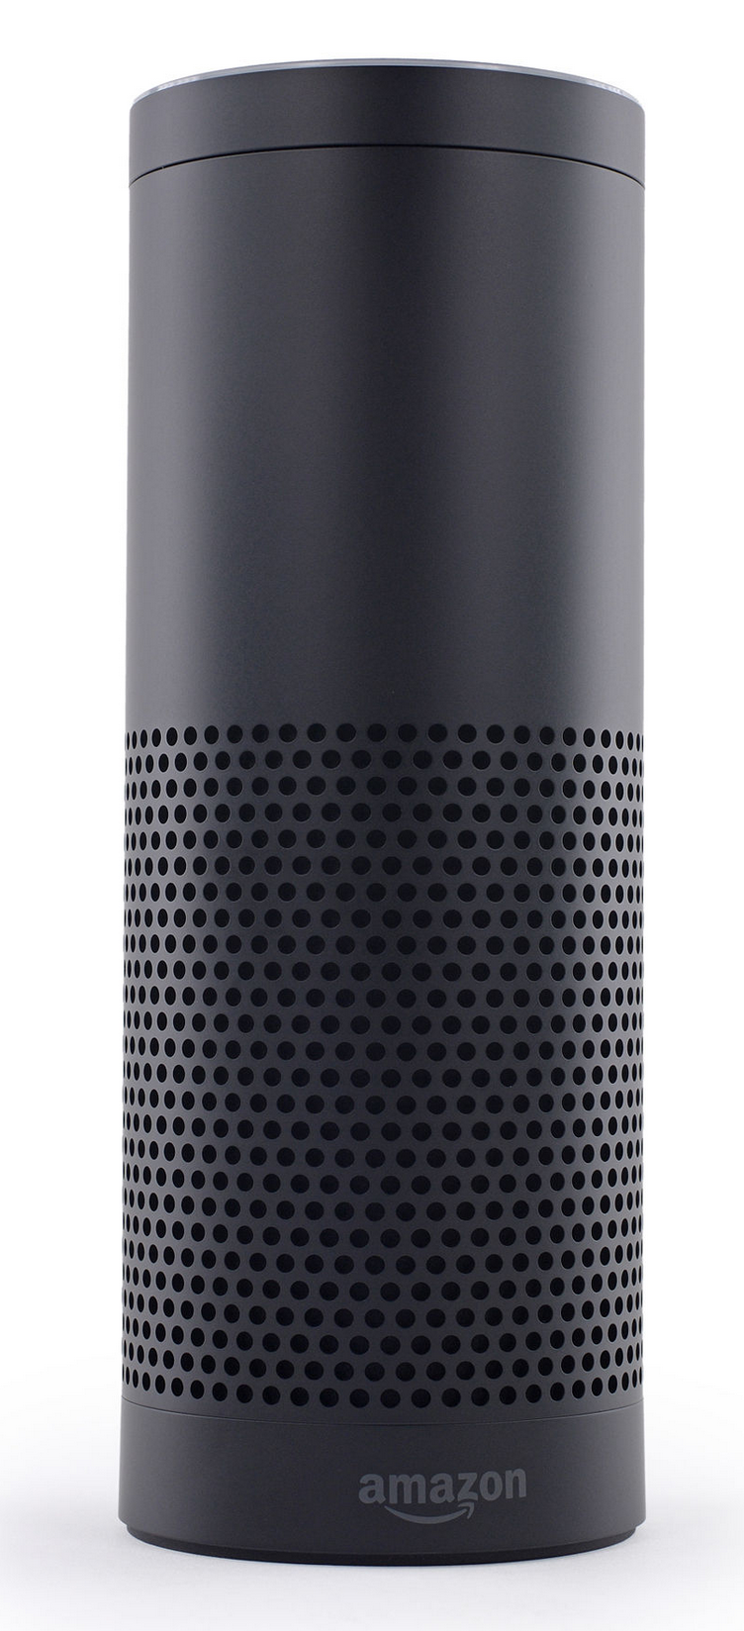
Embedded devices with dialogue capabilities
Amazon Echo (2014) – home assistant device
Plays music
With voice commands
Question answering
Get weather, news
More complex questions, like
“how many spoons are in a cup?”
Setting timer
Manages TODO lists

Slide 9
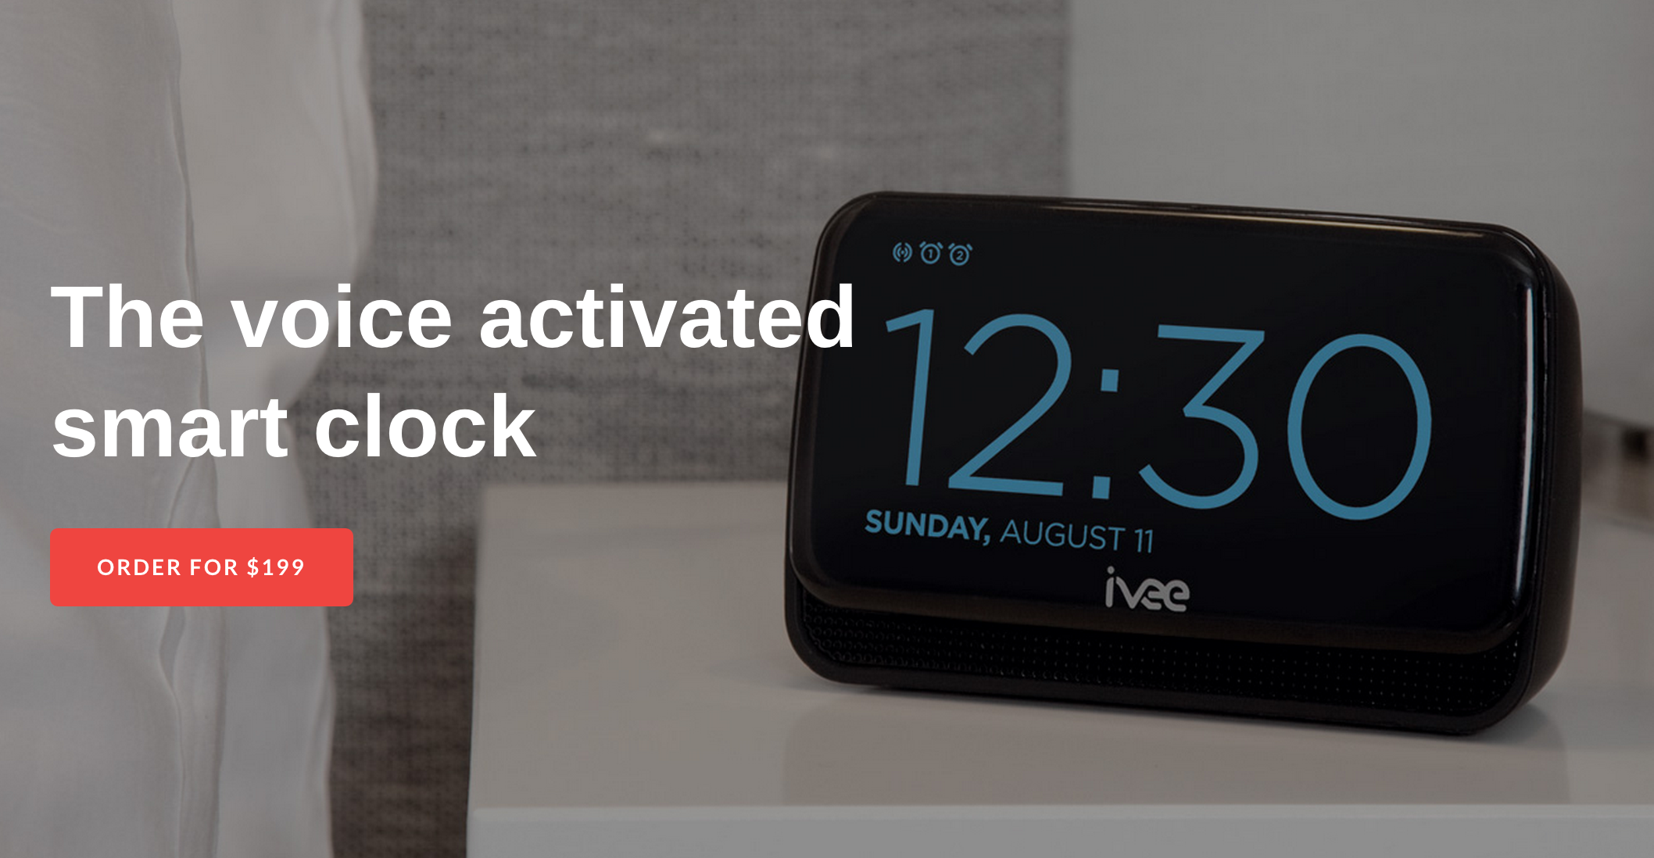
Embedded devices with dialogue capabilities
Answers questions
Sets time
Device control and queries.

Slide 10
How developers like us are using it

Slide 11
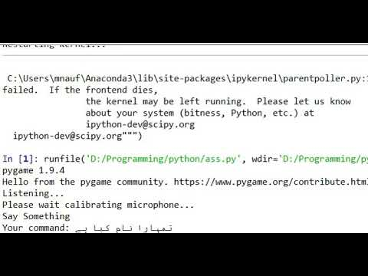
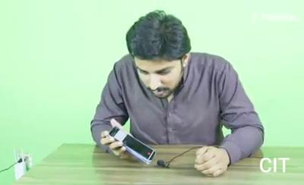
How developers like us are using it

Slide 12

Speech to Text Libraries/APIs
Google Speech API IBM Watson API SpeechAPI Speech to Text API Text-to-Speech API Rev.AI API ReadSpeaker API Speech2Topics API

Slide 13
Hands On?

Slide 14
Project 1
I'm thinking of one of these words: apple, banana, grape, orange, mango, lemon You have 3 tries to guess which one.
Guess 1. Speak! You said: banana Incorrect. Try again.
Guess 3. Speak! You said: Orange Correct! You win!

Slide 15
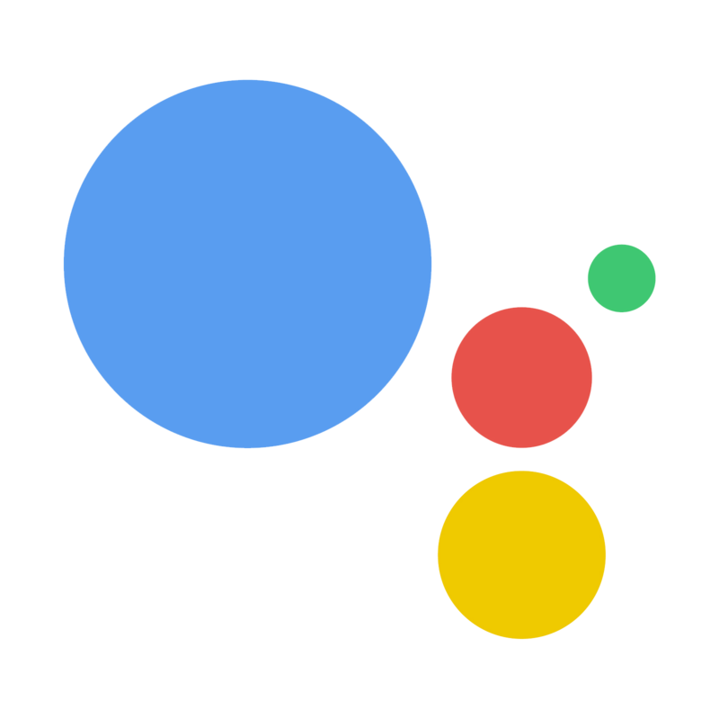
Project 2
Make your own digital personal assistant.

Slide 16
Acknowledgement
Some slides are taken from PIAIC IOT slides.

Slide 17



Let’s get connected
/muhammad.naufil
/in/muhammad-naufil-0554a5166
/mnauf

